Slide 1
Hopfield Network
Presentation

Slide 2
1. Definition
A Hopfield Network is a recurrent neural network designed to act as an associative memory system.
It stores information in a distributed form and retrieves complete patterns from partial or noisy inputs.
Simple Definition:
A Hopfield Network works like a memory that ‘cleans up’ messy information. If you give it an incomplete input,
it reconstructs the closest stored pattern.

Slide 3
2. Architecture
• Fully connected structure: every neuron is linked to every other neuron.
• No hidden layers.
• Symmetric weights: Wij = Wji ensuring stable convergence.
• No self-connections (Wii = 0).

Slide 4
3. Working Process
Step 1: Learning (Hebbian rule)
Connections strengthen when neurons activate together.
Step 2: Recall (Relaxation)
Neurons update their states based on neighbors until the network stabilizes and retrieves the stored pattern.

Slide 5
4. Advantages
• Recovers distorted or incomplete data
• Simple and decentralized processing
• Guaranteed convergence to stable memory states

Slide 6
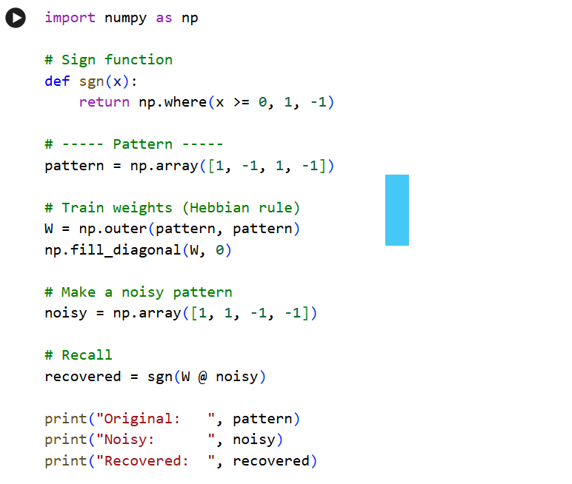
Code:

Slide 7

Output:

